Slide 1
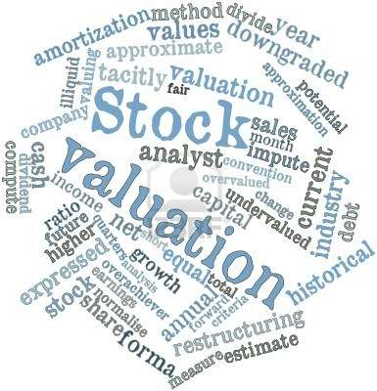
MMA 823 Analytics for Financial Markets
Instructor: Mehmet Beceren, Ph.D.
SESSION 1: Equity Financing & Stock Markets
Master of Management Analytics 2025

Slide 2
Agenda
Course Overview and Introduction
Corporate finance and shareholder equity
Stock prices and asset valuation
Team project discussion
Assignment 1 coming up
Lots to cover! Let’s start!

Slide 3
Introduction
MMA 823 Analytics for Financial Markets is an intensive course that covers a set of selected topics on the basics of financial markets, financial instruments, data and related quantitative methods.
The coursework will progress in two parallel channels:
First channel will cover the basics of financial instruments and financial market institutions.
MMA students will have the opportunity to build some practical knowledge on the uses and management of various financial instruments including derivatives.
Second channel will cover basic quantitative methods and related computational resources.
The students will work on hands-on data analysis and coding projects.
The objective of MMA823 is to provide exposure to a wide range of qualitative and quantitative analysis methods that are commonly applied in contemporary finance.
We will not dive deep into technical details or theoretical discussions. Our area of interest is the intersection of financial instrument basics & predictive data analysis.

Slide 4
Introduction
Essential Computer Tools: R/RStudio and/or Python with IDE (Spyder, Jupyter Notebooks, Colab etc.), Excel/VBA, in addition to the standard office suite
Essential Reading: Selected HBS Cases and Articles, financial market and economics news (WSJ, FT, Economist, etc. )
Useful Books: The course will not follow a single textbook closely but will use a set of selected materials from the following texts that are available through the online resources of Queens U Library.
Financial Risk Management and Financial Institutions by John C. Hull, John Wiley & Sons
Financial Economics, by F. Fabozzi, E. Neave and G. Zhou, John Wiley & Sons
R Programming and Its Applications in Financial Mathematics by Shuich Ohsaki, J. Ruppert-Felsot, D. Yoshikawa, CRC Press, 2018
Python for Finance Cookbook, by Eryk Lewinson, 2020
Mastering Pandas for Finance, by Michael Heydt, 2015
GPT or Gemini ☺

Slide 5
Grading
Individual Assignments: Assignments will provide an opportunity to review the fundamental knowledge and to perform hands-on data analysis work related to the subjects discussed during the lectures.
It is important to present neat, timely, professional-quality work in data-driven mini projects. Part of the weekly assignments will require reading cases and articles, and then answering a set of questions online, or in written form.
Assignment #1: Readings/Quiz
Assignment #2: Coding/Data
Assignment #3: Readings/Quiz
Team Project:
Project will be a bigger assignment that will combine ML modeling The students will need to show that they have mastered the analysis skills and the fundamental knowledge discussed throughout the term.
Project: Team presentation and file submission due on the day of the last session
50%
50%

Slide 6
Key Messages
Predictive data analysis methods such as deep learning etc. do not yield powerful ‘learning’ performance when used with financial markets (and economics) data sets to predict the future.
When we deal with unstable systems and when we have a sample of only one realized history, predictive reliability is very hard to come by.
Whether you work in the financial industry or not, you need to build an understanding of the financial markets and the macro-policy framework that influences the trends in the general business environment.
Over the past 50+ years, nominal money supply and financial leverage has grown way beyond the size of real economic activity. Therefore, financial market developments quickly and significantly influence the real economic dynamics and business risks along with policy.

Slide 7
Key Messages
In the age of AI euphoria, it is critical to understand how/when strong reliance on data may bring failure and how/when complex data analysis techniques can be used to produce sophisticated cons, trendy marketing, or to cover up fundamental incompetencies.
Programming for standard data analysis will cease to be a valuable skill, but data and method forensics will continue to be critical if the current AI euphoria continues.
Economics and finance deal with biological and social systems. Do not expect mechanical formulations (used in academic modeling) to work.
has
d
’Learning’ is essentially about figuring things out with experience. AI technologies allow the computers to gain and simulate experience by using large amounts of data.

Slide 8
Issues related to forecasting in finance and business
A historical data set generally does not provide useful information on repeated failures.
It shows the outcomes captured in a certain set of circumstances that may radically change over time.
To adopt AI techniques with such data sets might help us uncover some patterns that occurred in the past, but it would not necessarily yield any reliable predictions for the future.

Slide 9
Issues related to forecasting in finance and business
Sources of concern about the excessive use of ML techniques to build decision
models for complex social systems:
A unique sequence of historical events caused by incidental patterns of stochastic factors, and complex confounding effects, do not provide useful data sets that are sufficient to make reliable inferences about the future.
In other words, unlike many successful applications such as image recognition, complex pattern discoveries within historical data sets, may not amount to ’learning’ or ’intelligence’ of any sort.
2. Although the Train-Test-Validation cycle of the ML algorithms may generate
incidents of attractive back-test results (i.e. performance validations) on historical
data, the relation between the performance metrics and future reliability may be
highly uncertain.

Slide 10
Statistical flukes vs. predictive models
Assume that you are the manager of a company named Lucky Bets Co.
You believe in luck and in lucky people. You are in the gambling business, but you do not place bets on games. Instead, you place bets on lucky people. You provide funding for the gamblers that you think are lucky to win at the roulette table in return for a large share of the prizes they win.
The skillful data analysts of Lucky Bets Co. collect a large historical data set on many attributes of the addicted roulette players. The data set includes the players’ winning percentage over the past 5 years, amount of money they lost, age, height, profession, post code, shoe size, hair color, first letter of their names, star sign, and many others.
The analysts divide the data set into Train, Test and Validation samples, and then let the ML algorithms run the over-parameterized deep learning models, as they always do.
The analysts provide a combination of attributes that predict a higher probability of winning at the roulette table. The results are confirmed in the Validation (hold-out) sample as well.
What would you do?

Slide 11
Statistical flukes vs. predictive models
Before we jump to conclusions about the usefulness of a model, we should ask:
[ How similar is my case to the Lucky Bets Co’s problem?
Think of examples from HR applications (predicting a loyal employee!), sports betting (predicting game score!), match-making apps (predicting a long-term spouse!), and many other social settings. How far are they from the Luck Bets example?
See the paper, “Reliability issues…” on the course site for further discussion

Slide 12

Finance: Why do we need it (or Do we?)
Why do we need this financial part?
SUPPLY
DEMAND
Consumers/Households
Goods + Services + Capital
Labour + Capital
Financial Markets and Capital Allocation
Surplus Savings
Firms/Producers
Goods + Services + Capital
Goods + Services + Capital
Surplus Profits
Government
Goods + Services + Capital
Goods + Services + Capital
Surplus Revenue
What is this for?

Slide 13

Finance: pool of funds and allocation
SUPPLY
DEMAND
Consumers/Households
Loan, Credit, Insurance
To finance Residential / Personal Investment & Consumption
Surplus Savings
Goods & Services
Pool of Funds
Capital
To finance production & investment
Firms/Producers
Taxes
Surplus Profits
Goods & Services
Taxes
Capital
To finance production & investment & public services
Government
Surplus Revenue
Money Printing
Who should receive how much at what price?

Slide 14

Finance: Exchange of promises and trust
Promises flow this way
Cash flow glut
WMPs
Investment Banks
Pooled Funds
Asset Managers
Deferred consumption
Cash flow deficit
Asset wealth
Structured Products
Investment for Growth
Brokers
Contingent Claims
Insurance & Swaps
Brokers
Demand of Funds
Supply of Funds
Insurance
Equity Shares Joint-Partnership
Exchanges
Investment for Maintenance
Banks
Loans, Bonds, IOUs
Repayment of Liabilities
Central Bank
Cash, Money Market, FX
OTC Markets
Trust flows this way

Slide 15
Finance: does it have to operate in a market setting?
Promises flow this way
Cash flow glut
Deferred consumption
Cash flow deficit
Asset wealth
Investment for Growth
Demand of Funds
Supply of Funds
Investment for Maintenance
Repayment of Liabilities
Trust flows this way
Financial markets help us weigh and balance the promises and trust via the pricing mechanism. They are not perfect but the complexity of the problem dictates a market-based approach.
Really?
Is this a political conditioning of the current prevalent culture?

Slide 16
Economics is mostly smart-sounding arguments with scientific posing
Markets are not perfect but the complexity of the problem dictates a market-based approach.
Correct but don’t accept such “confident” statements easily. Be skeptic and analytical.
Is the complexity of the problem driven by:
Politics?
History?
Religion?
Nature?
What if the market itself becomes really large to create problems rather than solutions?
What if the market itself is the driver of increasing complexity?
Is it worthwhile to regulate the markets or does regulation create more problems?
Are markets actually what the economists imagine or dream of?

Slide 17
Economics is mostly smart-sounding arguments with scientific posing
Academic economics and finance disciplines try too hard to sound like science.
There is too much focus on math with little historical context especially in the 2nd half of the 20th century
That is changing
Common view was that economics trump politics- it is part of North American conformism
Academics are waking up to the facts of the world as they see politics trump economics – pun intended

Slide 18
Firm Financing Decisions: Equity vs. Debt
Firms invest in new plant and equipment to generate additional revenues and income (or to sustain current production). Earnings (=profits) generated by the firm belong to the owners and can either be paid to them as dividends or retained within the firm. The owners’ investment in the company is referred to as owners’ equity or, simply, equity.
Decisions about how the firm’s investments should be financed, whether with debt or equity, are referred to as capital structure decisions.
Debt and equity financing create different types of obligations for the company. The concept of leverage plays a role in affecting the company's financial risk because leverage amplifies the effects of outcomes.

Slide 19
Firm Financing Decisions: Equity vs. Debt
A firm's cost of capital is the cost of its long-term sources of funds: debt, common stock, and preferred stock, if any. The cost reflects the risk of the assets in which the firm invests.
The cost of each source of funds reflects the hierarchy of the financial risk associated with its seniority over the other sources.
For a given firm, the cost of funds raised through debt is normally less than the cost of funds from preferred stock, which, in turn, is less than the cost of funds from common stock. This is because creditors have seniority over preferred shareholders, who have seniority over common shareholders.
If there are difficulties in meeting obligations, the creditors receive their promised interest and principal before the preferred shareholders, who, in turn, receive their promised dividends before the common shareholders.
Estimating the cost of capital requires management to estimate the cost of each source of capital along with the amounts raised from each source.
Cost of debt is rather straightforward, but not cost of equity. Various factors and assumptions are included in ‘cost of equity’.
(What happens when a company announces share issues to finance its obligations? )

Slide 20
Firm Financing Decisions: Equity vs. Debt
There are 3 main factors that make debt-financing less costly than equity financing:
Capital structure hierarchy
Interest expense reducing the tax bill
Rate of income tax (capital gains or dividend income) paid by shareholders
>> At first sight, in perfect capital markets with no uncertainty, when tax advantages exist, debt financing looks more attractive.
>> Build up leverage as long as you have higher profit potential. (!) (think ROE breakdown)
>> In reality, that is not the case since debt capacity is limited. Higher leverage, brings higher operational risk and additional risk of financial distress.
In reality, there are many legal, economic, financial imperfections that limit debt capacity. It is difficult to formulate an optimal point-decision on capital structure. There is usually a two-way relationship between the firm’s decisions and the factors affecting the cost of capital.
We will come back to this later

Slide 21
Let’s start! Stockholders Equity and Stock Markets
Assignment already!
Below is an example of statement of stock holder equity
What is the book value of equity of AA by the end of 2000?
What is the difference between:
Book Value and Market Value of equity?
Common and Preferred stock?
Dividends and Stock Splits?
Read HBS Case: Introduction to Shareholders Equity
Channel 1> Basics of financial instruments: Equity
Book value of Shareholder Equity is an accounting entry that checks with Assets – Liability on the Balance Sheet.
Market value may vary wildly as a result of numerous factors.
?

Slide 22

How do investors value equity?
Economist’s Abstraction
In a perfect market with no uncertainty:
The value of the stockholders’ investment in the company depends on the cash flow the firm can generate and not on the amount raised in the capital markets to generate this cash flow. This is because amounts not raised in the capital market are effectively raised from retained earnings (i.e., by foregoing dividends), and in the presently assumed circumstances the opportunity cost of the latter equals the market rate of return required by investors that is paid on new financing. The same result obtains if the stockholders invest their own cash in the firm
Really?!
Value of the firm equals the present value of existing earnings plus the present value (net of investment cost) of the future growth opportunities that the firm plans to adopt. That is, cash earnings X(t) account for all earnings, both existing and those resulting from new investments, while the I(t) reflect the costs of adopting the new investments.
Isn’t this just ‘smart sounding’ tautology?

Slide 23
Common Misconceptions about Valuation
Myth 1: A valuation is an objective search for “true” value
• Truth 1.1: All valuations are biased. The only questions are how much and in which direction.
• Truth 1.2: The direction and magnitude of the bias in your valuation is directly proportional to who pays you and how much you are paid.
Myth 2.: A good valuation provides a precise estimate of value
• Truth 2.1: There are no precise valuations
• Truth 2.2: The payoff to valuation is greatest when valuation is least precise.
Myth 3: . The more quantitative a model, the better the valuation
• Truth 3.1: One’s understanding of a valuation model is inversely proportional to the number of inputs required for the model.
• Truth 3.2: Simpler valuation models do much better than complex ones.

Slide 24
Standard Company / Business Valuation Approaches in Practice
Investor’s Balance Sheet
Book Value: Backward looking, depends on accounting practices and conventions that vary across companies.
Market multiples: Benchmarking to industry or peer averages of valuation ratios
Discounted cash flow: Based on assumptions of growth, cost of capital, etc., assumes steady-state investment and growth, useful for scenario analysis
Liquidation Value: Fire-sale valuation, more relevant under financial distress
Replacement Value: Particularly useful when we have high inflation, provides estimate of current market value of fixed assets and working capital
Market Value: Needs actively traded securities, driven by erratic crowd sentiment
The left side of the balance sheet captures business investment by type of investment, the right side captures business investment by type of investor.
Read the Case titled
Business Valuation Standard Practices
How should we value an IPO then?
Read the Ferrari IPO Case

Slide 25
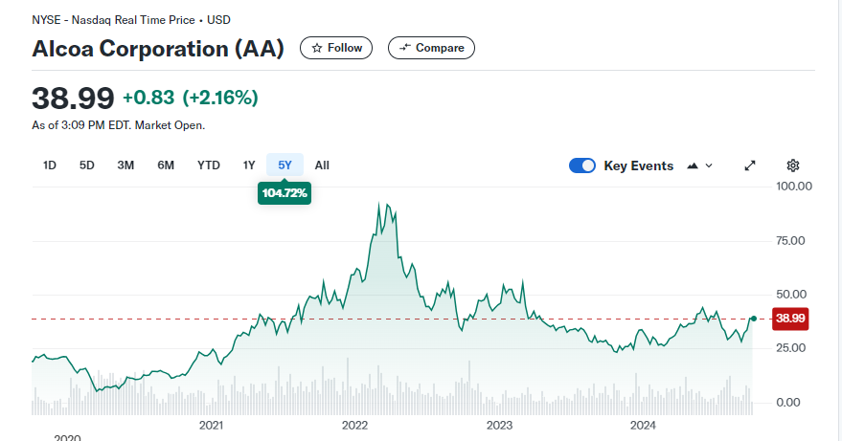
How do markets value publicly traded stocks? Market Price vs. Book Value
What determines these price movements?
Is there a model to predict?
There is a wide range of models with unreliable predictions. We do not have a good predictive for how/when/why and how much should individual stock prices fluctuate. We might have a bit more, but limited, success to explain relative price moves, however.
There seems to be temporary trends with highly variable fluctuations in price.
How do returns (% changes) look?
Are there any useful statistical properties?
Let’s collect historical data and generate the histogram of returns
>>>>

Slide 26






Firm Valuation in a World of Certainty
NPV of future earnings (or dividends) and growth
Constant growth rate g
These are imaginary parameters. Not observed, only inferred, or estimated!
k: constant proportion of earnings paid as dividends
A growth firm is one in which the expanding assets generate returns in excess of the market rate of interest.
In theory, price fluctuations should reflect the fluctuations in d, r and g. Therefore, we can infer about those imaginary parameters by looking at the market prices.

Slide 27
PE, EPS, Price of a Growth Firm
Let’s check AMZN’s PE Ratio historically…
Price
EPS

Slide 28
PE, EPS, Price of a Growth Firm

Slide 29
Stock Valuation: What about the human mind factor?
Let’s take a pause from the sophisticated sounding economist talk and quantitative tricks.
Let’s see examples of reality about ‘value’
How to Lose $20 Billion in Two Days – YouTube
GameStop stock short squeeze: Reddit traders take GME on a wild ride I FT Film – YouTube

Slide 30
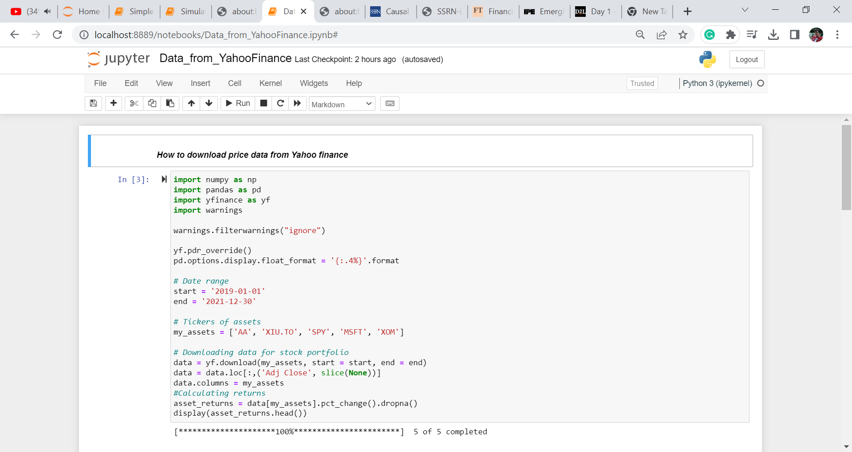
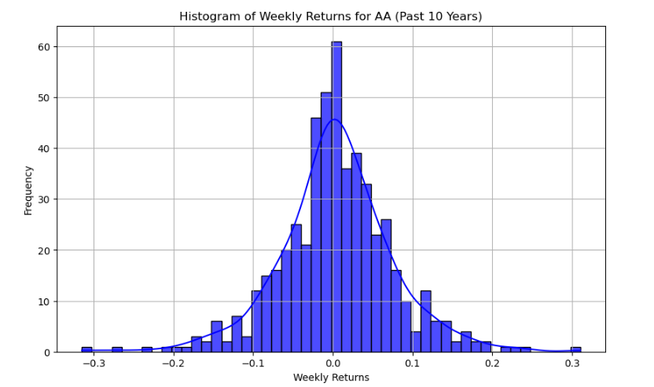
Historical Data Collection Example (Python)

Slide 31
From Historical Data to Simulation Scenarios
At this point, we have no idea why and how stock prices and returns change to predict the future movements. We only have the distribution of returns from historical data.
The returns seem to cluster around some average with a somewhat bell-shaped curve (Gaussian)
If we assume, historical data present a picture of likely events, the probability distribution of past data might guide us about the “statistics” to be observed in the future. (very strong assumption)
Let’s consider a set of stochastic processes that can help us specify the mathematical characteristics with parameters.
Specify the mathematical form of the price dynamics with a tractable stochastic function, and use the historical data to infer the parameters.
>>

Slide 32
Simple Stochastic Processes
Stochastic Process :
A function that generates values that are time and/or state dependent and show uncertainty. Not deterministic.
Finance, in essence, is about decisions under uncertainty about future outcomes. It is very rare that we find near-certain outcomes of economic decisions.
Financial markets are constructed environments that deliver price signals about the expected outcomes, and risks, and how desirable they are for the economic agents at a point in time.

Slide 33
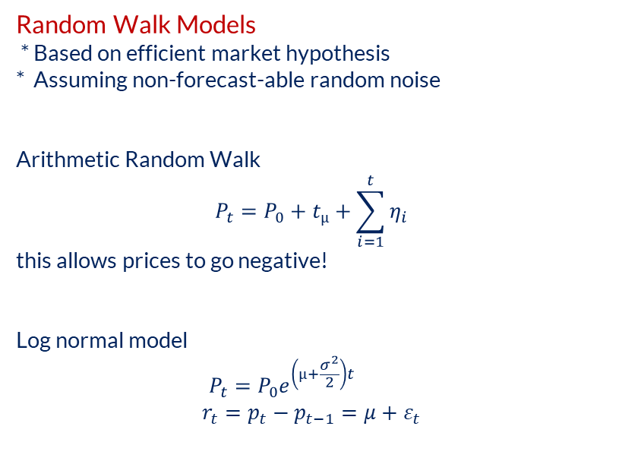
Simple Stochastic Processes
Random Walk Models
* Based on efficient market hypothesis
* Assuming non-forecast-able random noise
Arithmetic Random Walk
$$P_{t}=P_{0}+t_{µ}+\sum_{i=1}^{t}{η_{i}}$$
this allows prices to go negative!
Log normal model
$$P_{t}=P_{0}e^{\left(µ+\frac{σ^{2}}{2}\right)t}$$
$$r_{t}=p_{t}−p_{t−1}=μ+ε_{t}$$
Brownian Motion:
Brownian motion is formally represented by a continuous time Gaussian process, and has as a discrete time counterpart the random walk. By continuous time process it is meant that the process (e.g. the price, if we are modeling a stock price) evolves continuously in time, although we generally observe its values at discrete times.
The assumption of continuity has many advantages. An important one, is that the continuous model is independent of the timing intervals, and closed formulas for pricing might be possible (as opposed to recursive numerical procedures). Also the assumption of continuously evolving prices is fundamental for the derivation of the Black–Scholes option pricing formula.
Brownian motion, also known as Wiener process. This is the most fundamental continuous-time model in finance. On top of the Brownian motion other more elaborated continuous processes are built.

Slide 34
Simple Stochastic Processes
Brownian Motion:
Proportional to α
Some expected incremental change
+ Some erratic fluctuation
Proportional to σ
This is an extreme simplification but a reasonable starting point to the mathematics of behavior of financial asset prices.
Note that a mathematical representation such as above carries no information about how things work, or is supposed behave.
There is no science here, it is only some mathematical representation.
(Same is true for most of Finance! There is lots of mathematics of convenience with little understanding of the fundamental nature of the system. )

Slide 35
Simple Stochastic Processes
Geometric Brownian Motion:
Easy to simulate by compounding a drift and normally distributed fluctuations.
Use Excel, Python or R to create a simulation
Write a simple code that simulates a Geometric Brownian Motion. Use it to generate 5 different paths with the following parameters:
Starting Value = 100
Drift = 5% → mu
Simulation Period: 1 Year divided to 250 days (ie. 250 incremental steps of 1/250)
Volatility: 20% (annual)
Assume T stands for number of years.
Increment = 1/250

Slide 36

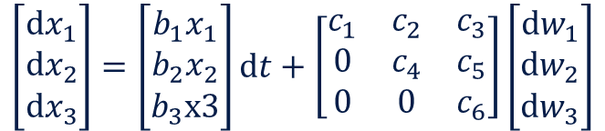





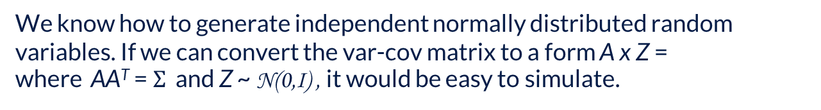
Simple Stochastic Processes of Portfolios
Correlated Multiple Geometric Brownian Motion Paths:
Consider the following
w_{i} are correlated Wiener processes. As a result, x1, x2, x3 are correlated Brownian motions with different drift rates. The elements of w_{i,t} are drawn from a multivariate normal distribution
$$ⅆx_{1,t}=b_{1}x_{1,t}ⅆt+ⅆw_{1,t}$$
$$ⅆx_{2,t}=b_{2}x_{2,t}ⅆt+ⅆw_{2,t}$$
$$ⅆx_{3,t}=b_{3}x_{3,t}ⅆt+ⅆw_{3,t}$$
$$N(0,Σ)$$
$Σ$ is the var-cov matrix
How can we simulate this multivariate random process that evolves with normally distributed error terms?
We know how to generate independent normally distributed random variables. If we can convert the var-cov matrix to a form A x Z =
where AA^{T} = $Σ$ and Z ~ N(0,I) , it would be easy to simulate.
$$N(0,Σ)$$
Cholesky Decomposition
$$\left[\begin{matrix}ⅆx_{1} \\ ⅆx_{2} \\ ⅆx_{3}\end{matrix}\right]=\left[\begin{matrix}b_{1}x_{1} \\ b_{2}x_{2} \\ b_{3}x3\end{matrix}\right]ⅆt+\left[\begin{matrix}c_{1} & c_{2} & c_{3} \\ 0 & c_{4} & c_{5} \\ 0 & 0 & c_{6}\end{matrix}\right]\left[\begin{matrix}ⅆw_{1} \\ ⅆw_{2} \\ ⅆw_{3}\end{matrix}\right]$$
N(0,I)
t
t
A
t

Slide 37
Portfolio Return Simulations
How can we simulate this multivariate random process that evolves with normally distributed error terms?
A simple R code
library(mvtnorm)
r_varcov = cov(stock_returns) # covariance matrix of historical returns or multiple stocks
r_mean = apply(stock_returns, 2, mean)
r_mean = colMeans(stock_returns)
sigma <- var (stock_returns)
x <- rmvnorm(n=500, mean=r_mean, sigma=r_varcov, method="chol")
We can infer from historical data
In Python, we can use the numpy module
Historical data is not necessarily a good guide for future scenarios.
And, multivariate normal distribution is not necessarily a good representation of the joint distributions.
We also try to anchor the expected returns (mu) and variances to some factors and/or forecast models.
Otherwise, dimensionality is too high. Scenarios are too random and extremely unstable.
t
t

Slide 38
Asset pricing models
(Basic) Asset pricing models, CAPM and APT
Stochastic process simulations look fancy, and reasonably close to the picture we get with real time series data, but they do not provide any insight or predictive value.
The outcome of a simulation is mainly shaped by the parameters we assume from the start.
We do not have any anchor to base our expectations or risk estimates for the future.
i.e. Returns and risks are independent from any economic driver or human behavior.
We need to construct a model/framework that links prices and risks to some factors embedded in economic reasoning.
It is easy to hypothesize about many possible factors but it is not straightforward to design a model that combines ‘supply’ and ‘demand’ with basic fundamentals of human behavior in a consistent manner.
The first model that has been successfully ‘complete’ in that sense is the CAPM,
Capital Asset Pricing Model.
t
t

Slide 39
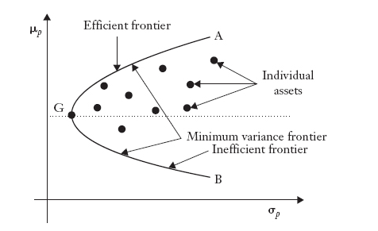
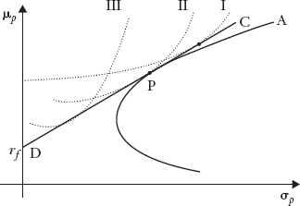

Asset pricing models
CAPM
The model is motivated by a set of seemingly strong and unrealistic assumptions.
Empirical support for the implied results of the model is controversial.
Nevertheless, the model builds a framework that specifies expected asset return and risk by using a norm of decision-making in portfolio construction.
The assumed norm of behavior is mean-variance portfolio construction.
Best mix of risk & return
t
t
CAPM reaches the conclusion that the optimal portfolio should be the market portfolio in equilibrium.*
(*) homogeneous preferences and expectations are the key

Slide 40
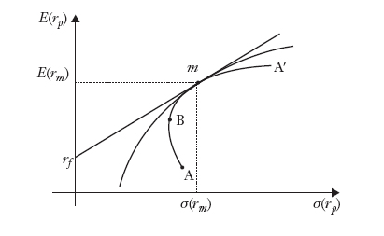




CAPM derivation in a nutshell
Optimize the weight of risky asset with respect to risk-free asset: Take the derivative with respect to weight…Then use the equality of the optimal choice and the market portfolio to reach:
t
t
The same conclusion is reached when quadratic utility of risk-averse agents are maximized. (point m is the optimal point again)

Slide 41


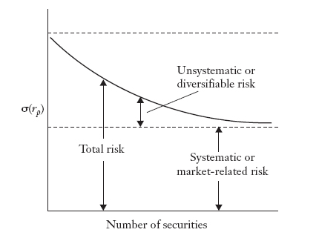
CAPM implications
CAPM says that when investors have homogeneous expectations and when certain additional assumptions hold, in equilibrium the value of α must be zero.
The total risk of a security or a portfolio is measured by its variance. Based on the regression given above, we can take the variance on both sides.
t
In contrast to unsystematic risk, systematic risk cannot be eliminated.
CAPM’s conclusion is that only systematic risk is rewarded.
> Differences in asset returns and risk must be driven by beta to systematic risk.
t
Macro factors

Slide 42
From CAPM to Arbitrage Pricing Theory
CAPM has been subject to academic research, empirical analysis and practitioner discussion for decades. Empirical evidence is controversial.
There are mainly 2 types empirical investigation:
Is alpha actually zero as the model suggests? If we run the regressions for many assets, estimate the alpha-term, do we see that they are, on average, not different from zero? i.e. Can we statistically reject the null hypothesis Ho: alpha==0?
(2) When we rank order the returns of assets over certain periods, do see them lining up with the value of their betas (exposure to market risk)?
In response to the failure of studies to support the CAPM, there have been several explanations as to why empirical tests of the CAPM are flawed.
For example, a paper by Richard Roll (1977) argues that despite the poor performance of suggested tests this may not speak to the true CAPM, which has never been tested and probably never will be. One reason is that the market portfolio is neither theoretically precisely defined, nor empirically well approximated.
>> Probably a valid argument but fails to support the model since the model gains an ‘untestable truth’ or a ‘redundant tautology’ status.
t
t

Slide 43
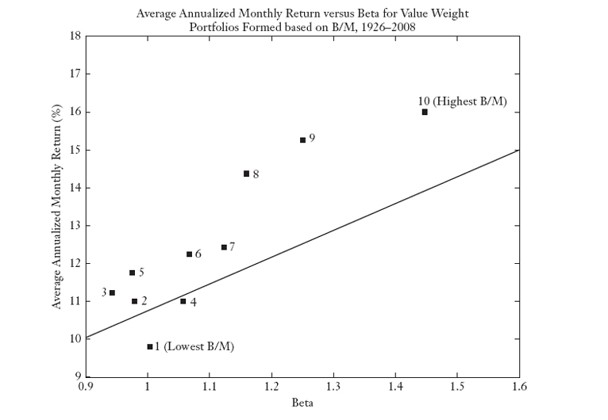

Search for other Risk Factors
CAPM has kept many academics and practitioners busy for decades despite its reliance on extremely strong assumptions. Because it opened the door to a framework of risk factors and asset exposures as the drivers of asset returns.
The ultimate question that the academics seek to answer is:
What drives the differences in the asset returns?
Investigation for risk exposures that help explain the cross-sectional variance of returns led to various factor models.
Researcher sliced and diced the assets (especially equities) to look for statistically distinguishable return behavior.
Factor models are proposed in the following form:

Slide 44
Arbitrage Pricing Theory (APT)
Intermediate layer that may managed or diversified
Common Factor Risk
The return-generating process is a statistical model used to measure the risk exposures of the asset returns.
It does not require drawing an economic conclusion, nor does it say anything about what the expected returns on the assets should be.
In other words, the alphas (α_{i}'s) in the return-generating process can statistically be any number. Only when no-arbitrage assumption is imposed APT says that the alphas should be linearly related to their risk exposures (betas).

Slide 45
Factors in Practice
The APT does not provide any specific information about what the factors are, nor does it make any claim regarding the number of factors. (In contrast, the CAPM claims a single factor and that factor is the market.)
The APT simply assumes that the returns are driven by the factors (another tautology?), and if the smart investors know the betas (via learning or estimating), then an arbitrage portfolio, which requires no investment but yields a positive return, can be formed if the APT-pricing relation is violated in the market.
In equilibrium if there are no arbitrage opportunities, we should not observe deviations from the APT-pricing relation.
Mainly Three Types of Factor Models in Practice
1. Macroeconomic factor model (Macro/Systematic Factors, external to assets)
Factors are observable economic and financial time series
2. Fundamental factor model (Driven by measured asset characteristics)
Factors are created from observable asset characteristics
3. Statistical factor model (Estimated from asset’s data, not measured)
Factors are unobservable and extracted from asset returns
They are made-up statistics such as technical indicators
Or, latent variables that inferred from data
Then, the differences in asset returns must be driven by the market participants that are seeking arbitrage opportunities originating from factor exposures.
What could those factors be?
Are there any prevalent and persistent factors that can be identified?

Slide 46
Next Session
More on factors and example codes
ML approaches to factor mining, its uses, abuses and limitations
Bonds, Rates, Yield Curves, Credit Risk
Online quiz on the Reading List (the HBS cases mentioned on the earlier slides + the article titled “Can Machines Learn Finance?” + “AI and Big Data in Investment, Section 1 (up to page 20)

